Slide 1
A data mining Approach to predict the breast cancer
A group presentation for Data Mining - CA2 by
Vignesh Muthumani (10385771)
Tarun Reddy (10383664)
Huda Belim (10376991)

Slide 2

Contents
1
Introduction
2
Business Understanding
3
Data Understanding
4
Data Preparation
5
Data Modelling
6
Deployment
7
Conclusion

Slide 3
Introduction
Breast cancer is one of the most common cancer along with lung and bronchus cancer, prostate cancer, colon cancer, and pancreatic cancer among other.
Almost 12% of all cancers identified are breast cancers and 25% of the cancers in women are breast related cancers.
The use of data mining algorithms in medical field is rapidly increasing because of the high prediction accuracy.
Doctors can treat the patients better by identifying the correct tumor or type of cancer using machine learning algorithms in R.
The correct identification results in treating the patient efficiently and reduce the cost on medicine, therefore increasing the quality and healthcare value.
We are predicting the outcome using the most used machine learning algorithms and compare them to find out the best performing one.

Slide 4
Contents
1
Introduction
2
Business Understanding
3
Data Understanding
4
Data Preparation
5
Data Modelling
6
Deployment
7
Conclusion

Slide 5
Business understanding
The main objective of this is to predict the correct type of tumor on patients. This can hugely benefit both the doctors and patients.
It helps lower the cost on medication for the patient and also correct identification and on-time treatment may save many lives.
Is it possible to predict the type of tumor for Breast Cancer with the help of a cancer patient’s record?

Slide 6
Contents
1
Introduction
2
Business Understanding
3
Data Understanding
4
Data Preparation
5
Data Modelling
6
Deployment
7
Conclusion

Slide 7
DATA understanding
The Breast Cancer dataset contains the diagnosis and a set of 30 features describing the characteristics of the cell nuclei present in the digitized image of a fine needle aspirate (FNA) of a breast mass. Ten real-valued features are computed for each cell nucleus.
The ‘mean’, standard error (‘SE’) and ‘worst’ (mean of the three largest values) of these features were computed for each image, resulting in 30 features.
Radius
Texture (SD of gray-scale values)
Perimeter
Area
Smoothness (local variation in radius lengths)
Compactness (perimeter^2 / area - 1.0)
Concavity (severity of concave portions of the contour)
Concave points (number of concave portions of the contour)
Symmetry
Fractal dimension ("coastline approximation" - 1)

Slide 8
Contents
1
Introduction
2
Business Understanding
3
Data Understanding
4
Data Preparation
5
Data Modelling
6
Deployment
7
Conclusion

Slide 9
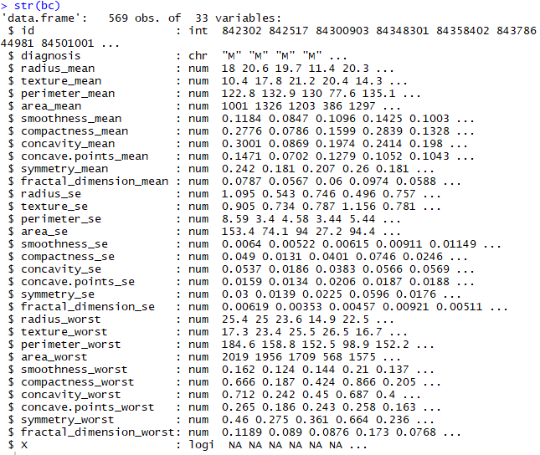
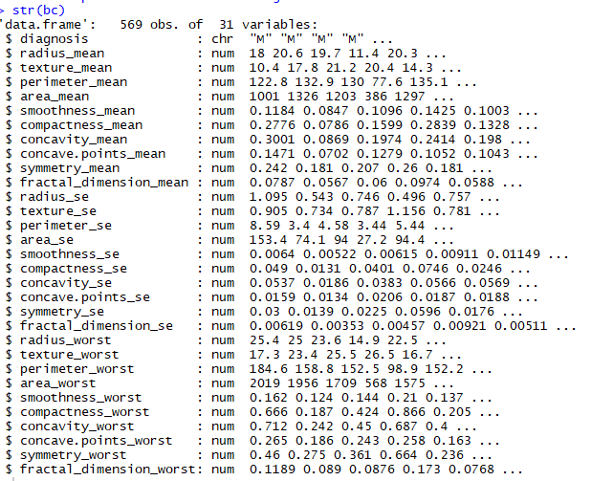
Data preparation
The data preparation stage involves in refining the raw dataset by removing the missing values, identifying outliers, feature selection, dimension reduction etc.
Removing unwanted variables: Here, we remove the first column ‘id’ and last column ‘x’ as they don’t provide any meaning information for our analysis.

Slide 10
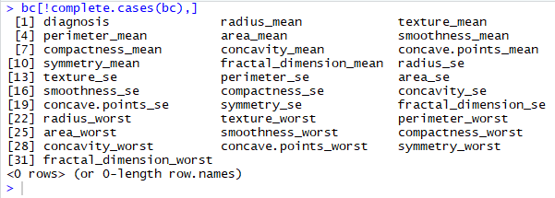
Data preparation (cont’d.)
Checking for missing values: We can see that there aren’t any missing values in our data.

Slide 11

Data preparation (cont’d.)
Converting the response variable into a factor: As we can see that the response variable is currently classified as a ‘character’, we convert it into a ‘factor’ variable with levels ‘Benign’ and ‘Malignant’.

Slide 12
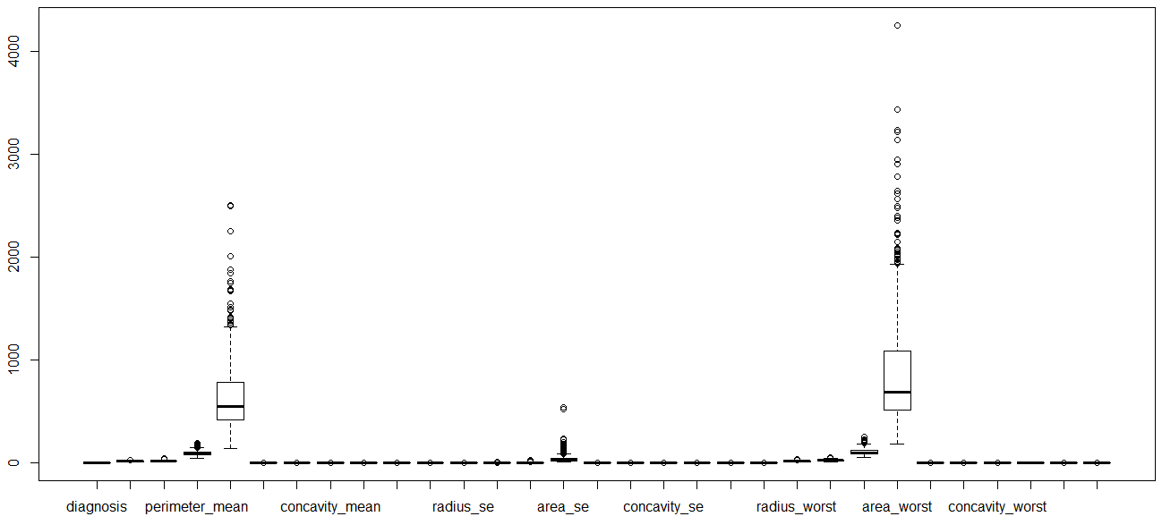
Data preparation (cont’d.)
Checking for outliers: We can see some significant outliers in ‘area mean’, ‘area se’, and ‘area worst’. However, we ignore these outliers. Based on our research, we found that these tumours could grow to any size and that the data is legit.

Slide 13
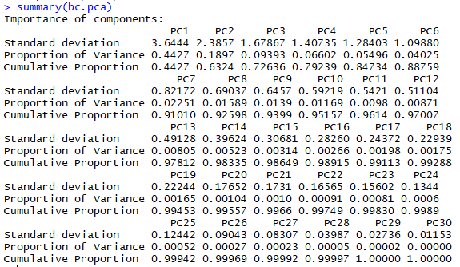
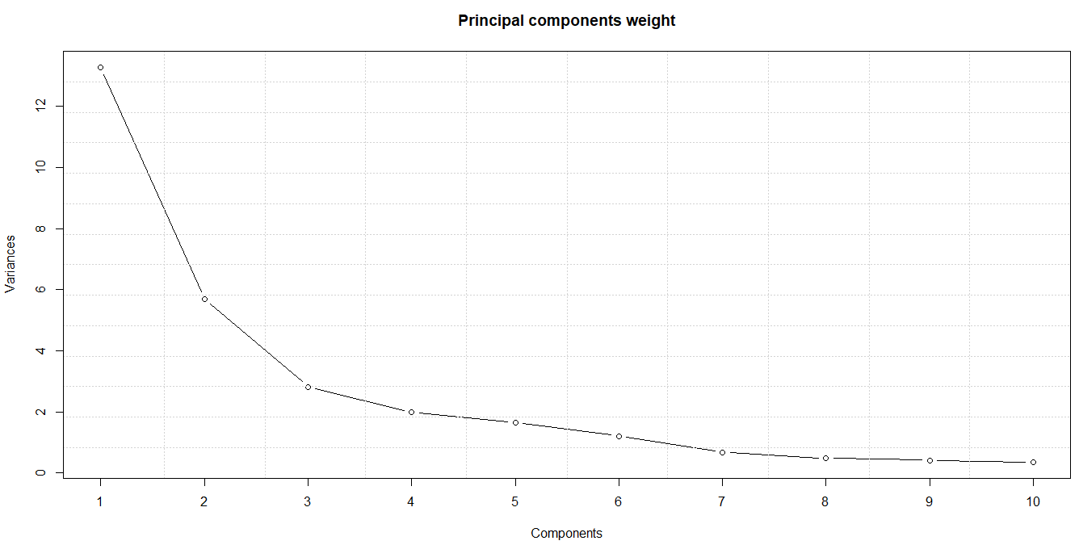
Principal component analysis
Too many variables can be a hindrance for effective data analysis as it makes the interpretation difficult and also decreases the efficiency by having variables that have no effect. Here, we perform this to reduce the variables with high correlation and standardize the data so that it can avoid data distortion caused by scale difference.

Slide 14
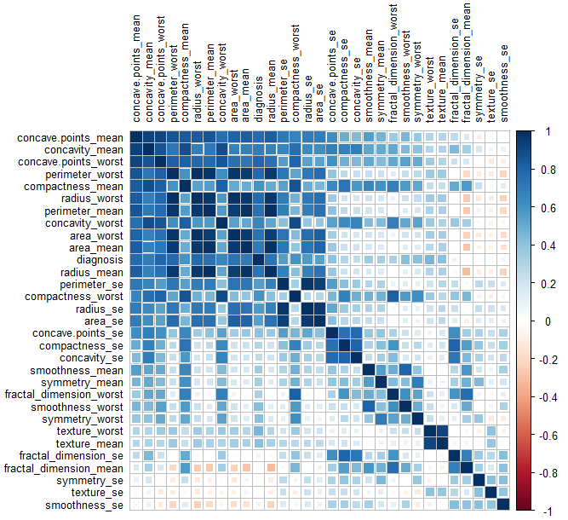
Correlation
Through the Pearson correlation analysis, we could see high correlations between the following variables.
Perimeter mean – radius worst
Area worst – radius worst
Perimeter worst – radius worst, area worst, area mean, radius mean
Texture mean – texture worst

Slide 15
Contents
1
Introduction
2
Business Understanding
3
Data Understanding
4
Data Preparation
5
Data Modelling
6
Deployment
7
Conclusion

Slide 16

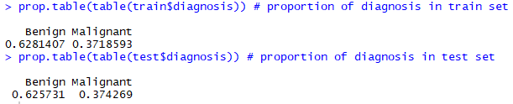
Data modelling
We split our refined dataset into train and test set in 70:30 ratio to model the train set and make predictions with the help of test set. Then we compare these predictions with the actual test set values to calculate its accuracy.
For data modelling, we use the following ‘classification’ machine learning algorithms
Naïve Bayes
Support Vector Machines
Random Forest

Slide 17
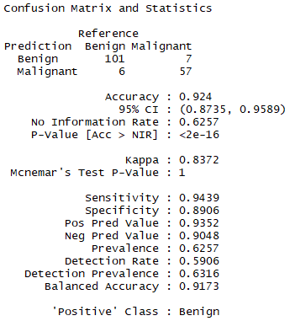
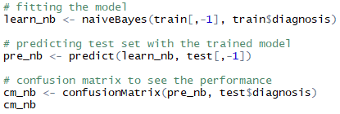
1. Naïve bayes
With the help of Naïve Bayes classification technique, we were able to build a model with 92% of accuracy in prediction of the test set with 13 incorrect predictions.

Slide 18
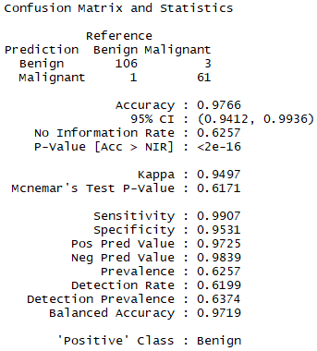
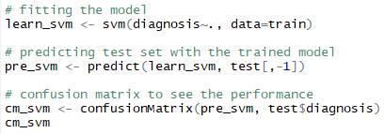
2. Support vector machine
With the help of Support Vector Machines (SVM) classification technique, we were able to build a model with an even greater accuracy of 98% in prediction of the test set with only 4 (1 false-positive and 3 false-negative) incorrect predictions.

Slide 19
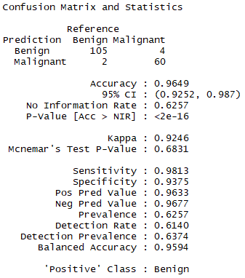
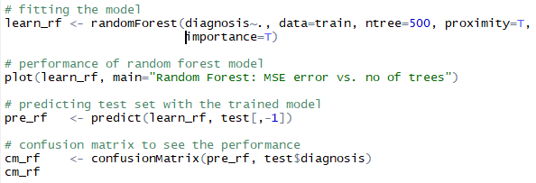
3. Random forest
With the help of Random Forest classification technique, we were able to build a model with a an accuracy of 96% in prediction of the test set with 6 (2 false-positive and 4 false-negative) incorrect predictions.

Slide 20
Contents
1
Introduction
2
Business Understanding
3
Data Understanding
4
Data Preparation
5
Data Modelling
6
Deployment
7
Conclusion

Slide 21
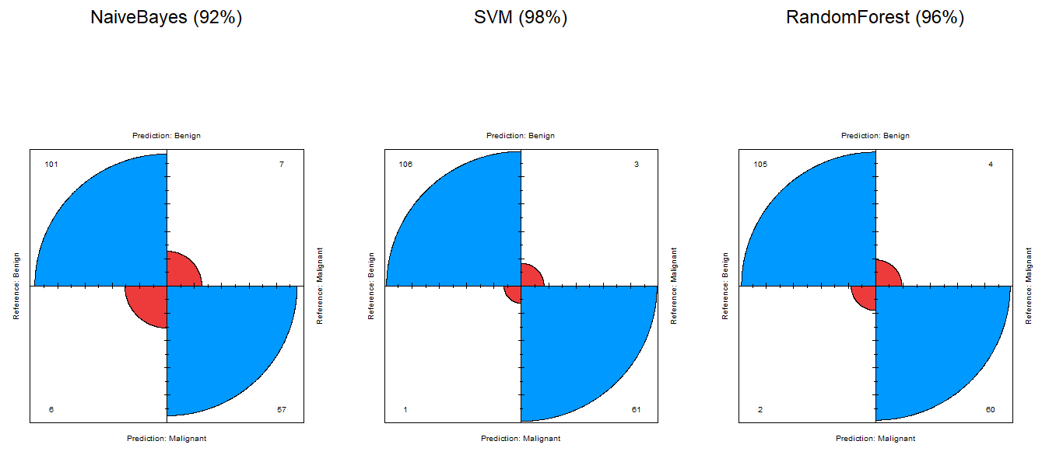
COMPARISON OF MODELS
Now that we have built 3 models, let’s compare their performances to determine which model performs the best with the help of four fold plot technique. We can see that SVM has performed the best of all, with an accuracy of 98%

Slide 22
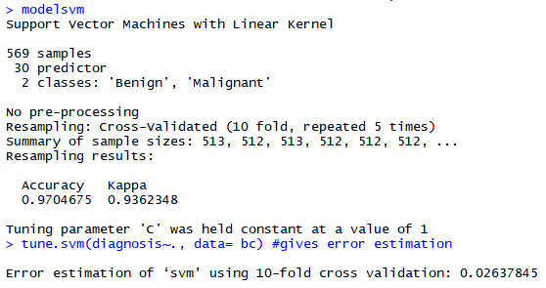
K-fold cross validation
Although SVM works better on our test set, it is quite important and beneficial to do a cross validation on the dataset just to double-check the accuracy and see if it’s consistent. Since our dataset is also smaller, it is quite important to perform the k-fold cross validation technique to see if the model’s performance is consistent.
From this output, we can see that our accuracy through 10-fold cross validation is 97%, which is just 0.6% lower than our initial test, though it doesn’t make a big difference, it proves that our model is consistent in performance. We can also see that the error estimation for the model is only 2%, yet again proving that SVM model outperforms all the other models.

Slide 23
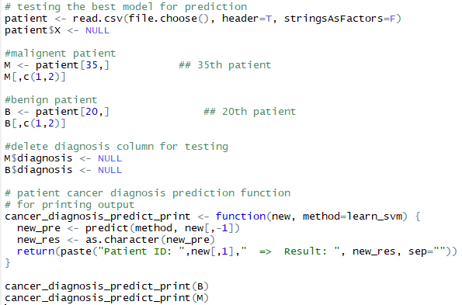

deployment
After finding out the best model we will test the model with new non-diagnosed data and see if the model can predict the correct type of tumour.

Slide 24
Contents
1
Introduction
2
Business Understanding
3
Data Understanding
4
Data Preparation
5
Data Modelling
6
Deployment
7
Conclusion

Slide 25
conclusion
With a data mining approach, we were successfully able to perform data analysis on the Wisconsin’s Breast Cancer dataset by following the CRISP-DM methodology of understanding the data, refining the data by fixing the inconsistencies, then by modelling the data for making prediction and finally by deploying the SVM model which performed the best. Then we did test for the deployed SVM model by feeding data which was not diagnosed, and the results were impressive by predicting the correct type of tumor.

Slide 26


